Slide 1
EER to Relational Model
Dr. S. RENUKA DEVI
Associate Profesor
SCSE
VIT Chennai Campus

Slide 2
Sample EER

Slide 3
8. Options for Mapping Specialization or Generalization
Convert each specialization with m subclasses {S1, S2, ..., Sm} and (generalized) superclass C, where the attributes of C are {k, a1, ...an} and k is the (primary) key, into relation schemas using one of the following options:
Option 8A: Multiple relations—superclass and subclasses
Create a relation L for C with attributes Attrs(L) = {k, a1, ..., an} and PK(L) = k
Create a relation Li for each subclass Si, 1 ≤ i ≤ m, with the attributes Attrs(Li) = {k} ∪ {attributes of Si} and PK(Li) = k
This option works for any specialization (total or partial, disjoint or overlapping).

Slide 4
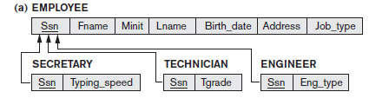
Mapping the EER schema using option 8A

Slide 5
8. Options for Mapping Specialization or Generalization (contd…)
Option 8B: Multiple relations—subclass relations only
Create a relation Li for each subclass Si, 1 ≤ i ≤ m, with the attributes Attrs(Li) = {attributes of Si} ∪ {k, a1, ..., an} and PK(Li) = k
This option only works for a specialization whose subclasses are total
Recommended if the specialization has the disjointedness constraint
If the specialization is overlapping, the same entity may be duplicated in several relations.

Slide 6
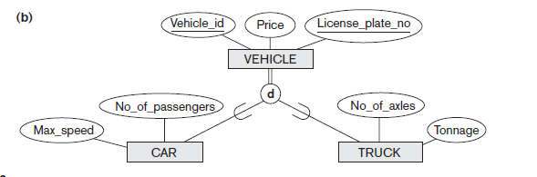
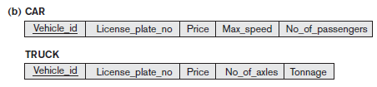
Mapping the EER schema using option 8B

Slide 7
8. Options for Mapping Specialization or Generalization (contd…)
Option 8C: Single relation with one type attribute
Create a single relation L with attributes Attrs(L) = {k, a1, ..., an} ∪ {attributes of S1} ∪ ... ∪ {attributes
of Sm} ∪ {t} and PK(L) = k
The attribute t is called a type (or discriminating) attribute whose value indicates the subclass to which each tuple belongs, if any
This option works only for a specialization whose subclasses are disjoint

Slide 8
Mapping the EER schema using option 8C

Slide 9
8. Options for Mapping Specialization or Generalization (contd…)
Option 8D: Single relation with multiple type attributes
Create a single relation schema L with attributes Attrs(L) = {k, a1, ..., an} ∪ {attributes of S1}∪ ... ∪ {attributes of Sm} ∪ {t1, t2, ..., tm} and PK(L) = k
Each ti, 1 ≤ i ≤ m, is a Boolean type attribute indicating whether a tuple belongs to subclass Si
This option is used for a specialization whose subclasses are overlapping (but will also work for a disjoint specialization)

Slide 10
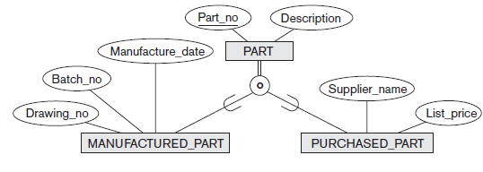
Mapping the EER schema using option 8D

Slide 11
Any Queries?

